Slide 1
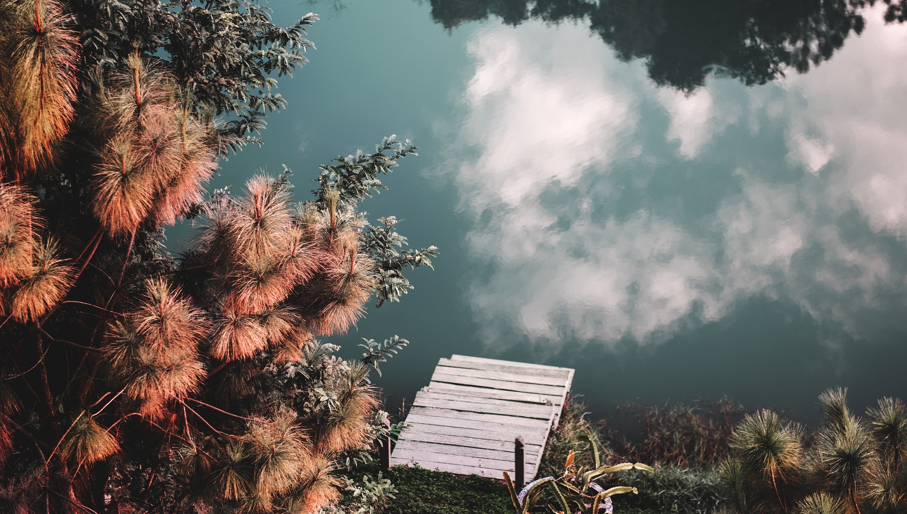
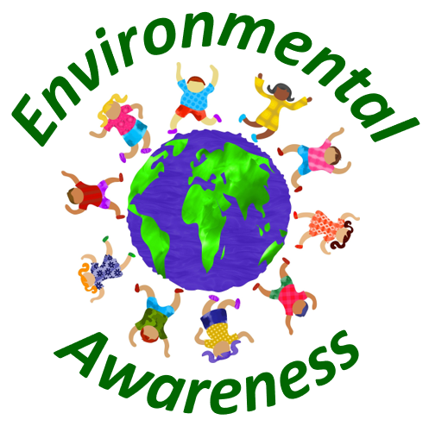
Ecosystems

Slide 2
What is an ecosystem?
An ecosystem can be defined as an interacting group of living organisms in conjunction with non-living environmental components.
Living and non-living organisms are closely through energy flows and the nutrient cycle.
There are many different types of ecosystems on our planet.
Intact ecosystems are crucial for our environmental system since they provide suitable living conditions for all kinds of living organisms.
In this article, many ecosystem-related questions are answered.
Moreover, the importance of ecosystems, potential dangers as well as solutions to these dangers are examined.

Slide 3
Types of ecosystems
Grassland ecosystems
Forests ecosystems
Rainforest ecosystems
Desert ecosystems
Savanna ecosystems
Taiga ecosystems
Tundra ecosystems
Lake ecosystems
River ecosystems
Marine ecosystems

Slide 4
Grassland ecosystems
Grasslands, also referred to as plains or prairie, are areas where the vegetation is dominated by grasses.
Grasslands can be found on almost all continents, except of Antarctica.
Grasslands can mainly be found in areas with annual temperatures ranging from -5 to 20 degree Celsius and annual precipitation between 600 and 1500 mm.
Grassland ecosystems can only be recognized as partial natural since there is often human intervention for farming and other purposes.
Through the use of excessive amount of fertilizer and pesticides, the variety of species in these ecosystems declined substantially over the last century.

Slide 5
Forests ecosystems
Forest ecosystems contain several kinds of trees, including conifers and leaf trees.
Forest ecosystems provide a habitat for many animals and plant species, although, compared to rainforests, the variety of animals and plants is quite limited.
Although forest ecosystems can be found on many continents, they are especially prevalent in Europe and America.

Slide 6
Rainforest ecosystems
Rainforest ecosystems can be characterized by high and steady rainfall.
Rainforest ecosystems, especially tropical rainforests, can be mainly found in South-America and Asia.
The most prominent example for rainforest ecosystem is the Amazon Rainforest.
Rainforests usually provide habitats for a huge variety of animal and plant species, many of them estimated to be unexplored by humans yet.

Slide 7
Desert ecosystems
Desert ecosystems are usually characterized by low amounts of rainfall and hot climatic conditions.
Since water is crucial for all life on earth, deserts often only have a low variety of animals and plants since living conditions for organisms are quite bad in these areas.

Slide 8
Savanna ecosystems
The savanna ecosystems are mixed grassland-woodland ecosystems which are usually characterized by trees being widely spaced.
Through the wide spread of the canopy of trees, enough sun can reach the ground and therefore lead to the growth of several grasses.
Savanna ecosystems provide a habitat for many animals, including lions, elephants and giraffes.

Slide 9
Taiga ecosystems
Taiga ecosystems, also referred to as snow forest, describes an area which is mainly characterized by coniferous forests.
It also often includes many lakes, rivers and untouched nature.
Taiga ecosystems are located in the northern hemisphere in North-America as well as in Europe and Asia.
Since average temperatures are usually quite low, the amount of species living in taiga ecosystems is rather limited.

Slide 10
Tundra ecosystems
Tundra ecosystems can be divided into Alpine tundra, Arctic tundra and Antarctic tundra.
Tundra is even more extreme in terms of low temperatures compared to Taiga ecosystems and therefore only contain a very limited number of animals and plants.

Slide 11
Lake ecosystems
Lake ecosystems are quite common on all continents and provide a habitat for a variety of animals and plants.
Depending on the eutrophication and the acidity level of lake environments, the number of species living in these environments can vary significantly.
For instance, a lake ecosystem will low eutrophication and therefore high levels of oxygen will be populated by more and also different kinds of fishes than one with low oxygen levels.

Slide 12
River ecosystems
River ecosystems are characterized by flowing water.
River ecosystems can reach thousands of miles and provide a habitat for a huge variety of animals, plants and other microorganisms.
Since river ecosystems differ in average temperature and also in oxygen levels, the number of living organisms can vary significantly over the different river ecosystems.

Slide 13
Marine ecosystems
Marine ecosystems are the largest aquatic ecosystems on our planet.
They provide a home for many sea animals, plants, corals and microorganisms.
Some parts of our oceans are still untouched by humans, which leads many scientists to believe that there exist many sea animals that are yet unexplored by humans.

Slide 14
Why are ecosystems important?
Natural habitat for animals and plants
Ecological balance
Food chain
Tourism
Air purification
Natural carbon dioxide storage
Pollination of crops
Economic benefits

Slide 15
Natural habitat for animals and plants
Our ecosystems are a natural habitat for a huge variety of animal and plant species.
Without the natural surroundings, plants would not be able to grow since they need nutrients from the soil and other components in order to keep existing.
Animals also need certain living conditions, including the right climate and also sufficient water supply.
They also rely on plants since for many animals, plants and their crops are their single source of food.
Therefore, for sustaining biodiversity, it is crucial to protect our natural ecosystems.

Slide 16
Ecological balance
Our planet is a big environmental system which is characterized by many different ecosystems.
However, these ecosystems interact with each other.
Moreover, also within an ecosystem, there are many complex processes that build on each other.
Even small changes in an ecosystem can lead to big effects through chain reactions.
For example, if a predator animal becomes extinct, the respective prey animals are likely to increase in numbers.
In turn, these prey animals will consume more plant material, which in turn leads to decrease in plant populations.
This cycle continues and it is hardly possible to estimate the end state.
Therefore, to ensure ecological balance, we have to make sure that we do not intervene to much in our ecological systems so that nature can develop in an original manner.

Slide 17
Food chain
The food chain is a complex process that often involves many different species.
For example, a cow consumes grass, the cow or products like milk are consumed by humans and the fecal waste from cows is used as fertilizer to grow grass again.
Therefore, trough the food chain, it is crucial to keep ecological systems intact in order to ensure enough food for the human population and also for a variety of animals.

Slide 18
Tourism
Many developing countries rely on tourism as their main source of income.
They realize that their most important resource is their nature.
Many tourists travel each year to remote parts of the world in order to see ecosystems and their respective animals and plants.
Thus, an intact ecosystem is crucial for the livelihood of many people who rely on tourism.

Slide 19
Air purification
Our ecosystems are a natural tool for air purification.
This is especially true for areas which contain a big fraction of forests.
Since trees filter out harmful substances of all sorts, they contribute to a better air quality.
Also, particle pollution is much lower in areas with a high number of trees.

Slide 20
Natural carbon dioxide storage
Trees are a natural storage space for harmful gases like carbon dioxide.
Through photosynthesis, trees absorb carbon dioxide and produce oxygen.
Therefore, on the one hand, animals and humans are supplied with oxygen.
On the other hand, through the absorption of carbon dioxide, global warming is slowed down.
Thus, our ecosystems are crucial to mitigate the global warming problem and also provide essential amounts of oxygen.

Slide 21
Pollination of crops
Ecosystems and the related species are also crucial for the pollination of crops.
This is especially important when it comes to agriculture.
Without insects pollinating the crops, farmers would suffer from substantial losses in yields.
Therefore, intact ecosystems with a variety of insects are crucial to support farming and thus to ensure the supply with basic food items.

Slide 22
Economic benefits
Our ecosystems provide us with a vast number of precious resources every day.
Without our ecosystems, we would not be able to produce large amounts of material goods and would also not be able to meet our daily demand for food and drinks.
Our ecosystems also provide many resources which can be used in industrial processes.
Therefore, countries with intact ecosystems tend to also have an economic advantage since they can harvest more resources which in turn means an advantage in the production of material goods.

Slide 23
Dangers to our ecosystems
Mining
Deforestation
Soil pollution
Littering
Illegal dumping
Acid rain
Global warming
Water pollution
Overpopulation

Slide 24
Mining
Mining can be quite harmful to our ecosystems since it often involves the destruction of large natural habitats.
For mining purposes, large areas of lands have to be processed.
By doing so, the plant live in these areas is significantly damaged.
Moreover, also animals living in the surrounding areas are likely to leave those areas since they feel not comfortable in the presence of humans.

Slide 25
Deforestation
Deforestation is a big problem, especially in the Amazon Rainforest.
Large areas of forest are cut or burned down every day.
Fires are even often started intentionally since farmers want to get more land to grow crops since it is more profitable than selling wood.
Deforestation implies the destruction of habitats for many animals and plants.
These animals either have to relocate or they will die since they lose their livelihood through the deforestation process.

Slide 26
Soil pollution
Soil pollution is another significant danger to our ecosystems.
In many industrial process, harmful by-products and waste are not disposed and separated in an appropriate manner, which can cause serious soil pollution.
Moreover, through the excessive use of fertilizers and pesticides, the soil is often polluted with harmful components which can hurt the soil in the long run and make it less fertile.
This in turn may lead to a decrease in plant species since their natural growing conditions have been altered in an adverse manner.

Slide 27
Littering
Littering can be a problem for our ecosystems if the litter contains harmful or even toxic substances.
For example, if people dispose their used cigarettes in forests or other natural ecological systems, animals may try to eat them and may die or suffer from severe illness because of that.
Moreover, through the incorrect disposal of used cigarettes, many wildfires are started each year and habitats for many animals and plants get destroyed.

Slide 28
Illegal dumping
Illegal dumping is a big ecological problem, especially in poor developing countries where regulation standards regarding waste disposal are not strict enough.
Industries often just dump their trash in nearby rivers or lakes, which leads to significant water pollution and therefore hurts a big variety of animals, plants and other organisms.

Slide 29
Acid rain
Acid rain can also hurt ecosystems since it alters the acidity level of the soil.
Plants are usually quite sensitive when it comes to altering their natural growing conditions.
Thus, through acid rain, the growth and reproduction behavior of plants may be altered in an adverse manner.

Slide 30
Global warming
Global warming is a big threat to ecological systems, especially for those who depend on a steady air and water temperature.
Through global warming, many parameters related to the living conditions of organisms are altered.
This is problematic since animals have been adopting to living conditions for millions of years.
A rather quick change in average temperatures will likely lead to a decline in biodiversity since animals and plants will not be able to adapt in this short time frame.

Slide 31
Water pollution
Water pollution can significantly impact many animals, plants and other organisms which rely on high quality water.
This is especially true for many fishes which require a stable level of oxygen and clean water.
If the water gets polluted, for example through illegal dumping or other industrial processes, many water animals will die because of that.

Slide 32
Overpopulation
Overpopulation implies severe consequences for many ecological systems.
If the number of people on our planet is growing, this implies that we need more areas for housing.
These areas had been previously used by nature, which implies a destruction of habitats.
Moreover, we need more areas for farming in order to ensure our worldwide supply with food, which also leads to a destruction of habitats.
A higher number of people usually also implies more waste and higher pollution, which also hurts many ecosystems.
Therefore, overpopulation can have serious adverse effects on our ecosystems.

Slide 33
Solutions to dangers to our ecosystems
Government regulations
Climate goals
Higher fines for illegal dumping
Subsidies for environmentally-friendly technologies
Stop deforestation
Restoration of ecosystems
Reduce your consumption behavior

Slide 34
Government regulations
To prevent adverse impacts on our ecosystems, government have to set strict regulations regarding several kinds of pollutions and also regarding the destruction of habitats.
We have to ensure that there is enough recreational space for nature to recover from human interventions.
We also have to make sure that endangered species are protected by law and that there are high fines for killing or collecting those species.

Slide 35
Climate goals
One important factor for sustaining our ecosystems is to fight global warming.
To accomplish this goal, we have to work together on a worldwide basis.
It is therefore crucial to set strict climate goals and to punish countries which do not care or are not able to reach these goals.
By doing so, we can limit the adverse effects of global warming on our ecosystems.

Slide 36
Higher fines for illegal dumping
Illegal dumping is a serious problem, especially in developing countries with a low level of control instances and low fines for illegal dumping.
We have to make sure that illegal dumping is punished more rigorously so that companies have a big incentive to refrain from dumping their waste in rivers and lakes.
Through higher fines, we can mitigate the extent of illegal dumping and also the implied adverse effects for our ecosystems.

Slide 37
Subsidies for environmentally-friendly technologies
Governments should also make sure that there is enough incentive for companies to develop sophisticated environmentally-friendly technologies.
This may come in the form of financial subsidies for companies which make substantial efforts in this direction.
By giving companies a financial incentive to research for eco-friendly technologies, we can improve our worldwide ecological footprint and can improve the natural conditions for our ecological systems.

Slide 38
Stop deforestation
In order to ensure suitable living conditions in our ecosystems, we have to stop deforestation.
Governments in the affected countries have to act in a much stricter way to fight deforestation and illegal logging.
For instance, the Amazon rainforest is an ecological system which is the home for a vast number of animals and plants.
However, it is threatened to vanish from our planet if the deforestation process continues.
Thus, it is crucial to stop deforestation and therefore to protect the habitats of a variety of animals and plants.

Slide 39
Restoration of ecosystems
The restoration of ecosystems is another measure in order to improve the living conditions of several animals, plants and other organisms.
However, restoring whole ecosystems can be quite difficult since it is not easy to restore natural living conditions.
Therefore, the focus should lie on the protection of ecosystems rather than on restoration of habitats which can only be seen as supplementary measure.

Slide 40
Reduce your consumption behavior
Our consumption behavior also contributes to the destruction of ecosystems since for the production of material goods, resources have to be extracted out of the ground which in turn destroys natural habitats.
Moreover, the production process implies several kinds of pollution, which can also hurt many ecosystems.

Slide 41
Conclusion
Our ecosystems provide habitats for a vast variety of animals, plants and other organisms.
Without our ecosystems, we would not exist as a human species.
We will also heavily rely on intact ecosystems in the future.
Only with intact ecosystems, we will be able to grow enough food to supply enough energy for a growing world population.
Moreover, the global warming process can only be mitigated if we save our forest ecosystems since they naturally store harmful greenhouse gases.
Governments all over the world have to work together to fight global warming in an efficient manner so that we can prevent the destruction of many ecological system and therefore the destruction of the livelihood of many people.
You can contribute to a preservation of ecosystems on a daily basis through a reduction of your consumption level.
Only if everyone contributes to the protection of our environmental system, we can ensure a livable future for the next generations.

Slide 42
Sources
https://www.biology-online.org/dictionary/Ecosystem
https://en.wikipedia.org/wiki/Ecosystem
https://sciencing.com/types-environmental-ecosystems-8640.html
https://en.wikipedia.org/wiki/Rainforest

