Slide 1
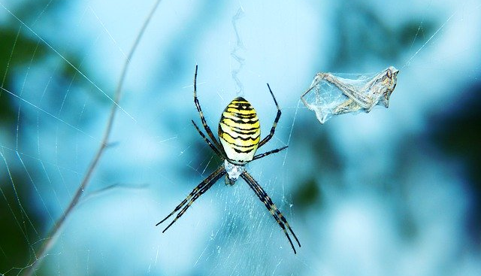
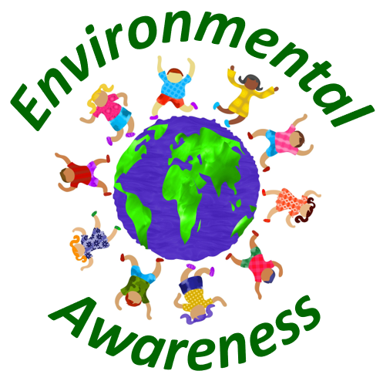
Food Web Disruption

Slide 2
What is a food web?
A food web (also sometimes referred to as food cycle or consumer resource system) can be defined as the interconnection of food chains.
In layman’s terms, it basically shows who eats whom in an ecosystem.
Working natural food webs are crucial for the health of our planet.
However, there are several ways how our food webs can be disrupted.
In this presentation, the causes, effects and solutions for a disruption of food webs are examined.

Slide 3
Causes for disruptions in the food web
Overpopulation
Water pollution
Acid rain
Climate change
Air pollution
Illegal hunting
Soil pollution
Illegal dumping
Littering
Mining
Deforestation
Human greed
Natural causes

Slide 4
Overpopulation
With the number of people on our planet increasing at a quite fast pace, we as humanity face severe environmental problems.
For instance, overpopulation leads to excessive overall consumption levels, which will not be sustainable in the long run.
This excessive consumption also implies the production of large amounts of waste.
Moreover, it also implies high levels of pollution.
All those factors may lead to the disruption of food webs since the local flora and fauna is usually quite sensitive to changes in natural living conditions and may not be able to adapt to these changes properly.
Therefore, some animal or plants species may decrease in population, which in turn starts a chain reaction since food webs are interconnected constructs.
If a prey animal decreases in population, also predator animals may decrease in population since they do no longer find sufficient food.
Depending on the severity of the adverse changes in natural conditions, the disruptions in the food web can be quite large.

Slide 5
Water pollution
Our rivers, lakes and oceans are quite sensitive ecosystems.
If the water becomes polluted through human interventions of several sorts, chances are that also aquatic animals and plants may significantly suffer from this pollution.
This means that aquatic animals may leave the polluted areas and may settle down in other areas far away from the pollution source.
However, plants can usually not relocate.
Therefore, plants that are close to pollution sources may decrease in population or may entirely die off, depending on the level of pollution.
In turn, whole food webs may be affected and disrupted.

Slide 6
Acid rain
Although it is still regarded as rather minor environmental issue by the general public, acid rain can have severe environmental effects.
This is also true when it comes to changes in the food chain and food webs.
For instance, many plants are quite sensitive to the acidity level of the soil.
If acid rain increases the acidity level of the soil, those plants will likely not be able to adapt to those new circumstances and may decrease in population.
Also, their growth behavior and crop yields might be adversely affected.
In turn, animals who rely on those plants as a food source may also decrease in population, since their food supply has been lowered.
Thus, a chain reaction may start and the food web as a whole may be adversely affected.

Slide 7
Climate change
Global warming can also cause significant problems to our food webs.
If the global air and water temperature increases, many animals and plants may no longer be able to sustain their population.
For example, fishes are usually quite sensitive to changes in water temperature since the higher the water temperature, the less oxygen will be in the water.
Thus, many fishes may die due to increasing water temperatures, which may in turn affect the food web in a rather unpredictable manner.

Slide 8
Air pollution
The pollution of our atmosphere with harmful greenhouse gases and other toxic substances is a great environmental problem, which, apart from the negative effects on us humans, may also hurt a variety of animals and plants.
Air pollution contributes to global warming and may also lead to ozone layer depletion and acid rain, which in turn could hurt and alter a variety of food chains and food webs.

Slide 9
Illegal hunting
Illegal hunting is still a big problem in some countries on our planet.
Especially in poor countries, hunting elephants and selling their ivory tasks on the black market can make locals a fortune.
This gives the poor population great incentives to hunt those animals.
However, this also implies the endangerment of certain species due to illegal hunting practices.
If only a few species in the food chain become endangered or even extinct, this could result in large changes in food chains, which in turn will also adversely affect the respective food webs.

Slide 10
Soil pollution
The pollution of the soil can lead to severe distortions in the food web.
For instance, if in some regions, the soil gets polluted by excessive levels of waste from landfills or illegal dumping, plants in those regions tend to decline in population.
In turn, also animals which rely on those plants as main food source are likely to decrease in population.
The circle continues since predator animals which rely on the prey animals which decreased in population may now also suffer from a decrease in population and so on.
It is difficult to figure out how this affects the food web as a whole since there are so many complex interactions and interdependencies that have to be taken into account so that the final outcome is hard to predict.

Slide 11
Illegal dumping
Another cause for a disruption in food webs can be illegal dumping.
In many countries, especially in poor developing countries with low levels of regulation and supervision regarding waste disposal, large amounts of waste are illegally disposed into rivers or lakes.
In turn, this leads to significant water and soil pollution and affects whole food webs in an unnatural manner.

Slide 12
Littering
Littering can also bring food webs out of balance.
Many people still dispose their garbage into nature and seemingly do not care at all about the negative consequences for our ecosystems.
Some litter contains harmful or even toxic elements, which can pollute the soil and also nearby water sources as well as our groundwater.
In turn, a variety of animals and plants may be adversely affected in their natural living conditions, which may lead to a decline in population for those species.
In turn, there may also be significant effects on the whole food web.

Slide 13
Mining
Due to our growing world population, also our mining activities increased drastically over the past decades.
This is not only true for conventional mining, but also for deep sea mining.
Thus, large areas of land and ocean ground are processed and used for mining activities, which in turn implies significant destructions of natural habitats.
This may lead whole ecosystems to get out of balance in the long run.

Slide 14
Deforestation
Deforestation is a significant environmental problem, especially when it comes to the destruction of our tropical rainforest.
For instance, in the Amazon Rainforest, large areas of forest have been cut or burned down in order to get more space for farming purposes.
However, this also implies the destruction of whole ecosystems.
The rainforests on our planet are habitat for most of our global animal and plant species.
If we destroy these rainforests, we will contribute to the endangerment and even extinction of myriads of species.
In turn, whole food webs and ecosystems may collapse with still unknown consequences for our planet and for humanity.

Slide 15
Human greed
Humans can be quite greedy.
Thus, we as humanity often exploit whole ecosystems just for the purpose of making money and to extract resources.
However, this greedy behavior often implies the destruction of habitats for a variety of animals and plants, which in turn may lead to a collapse of local food webs if those destructions are severe enough.

Slide 16
Natural causes
Apart from human-made causes, food webs can also be destroyed due to natural disasters.
For instance, the eruption of a volcano may significantly affect the local food chain and food web in the short term.
However, nature is usually quite clever and will restore and stabilize the natural food web in the long run.

Slide 17
Effects of the disruption of food webs
Imbalance of environments
Endangerment of animals and plant species
Migration of animals
Biodiversity loss
Loss of human food sources
Social tensions
Poverty
Starvation

Slide 18
Imbalance of environments
The destruction or altering of food webs can lead to an imbalance of whole ecosystems.
For instance, if one prey species decreases in population or even goes extinct, other predator species which relied on the prey species as a food source may also be in serious trouble since their food supply diminished or even vanished.
In turn, the predator species may also suffer from a serious decline in population.
However, other species may now increase in population since there are less predators around.
The overall effects of changes in the food chain and food webs are hard to predict since there are so many interconnections.
However, serious changes in the food web may bring local ecosystems out of balance, which may lead to serious consequences for our environment as a whole.

Slide 19
Endangerment of animals and plant species
Due to disruptions of the food web, many plant and animal species may become endangered or even extinct.
This is especially true for our tropical rainforests since they are the habitat for most of our global animal and plant species.
If those food webs get disturbed, many species are likely to become endangered or extinct, with still unpredictable overall consequences for our planet as well as for humanity.

Slide 20
Migration of animals
Many animals may also be forced to leave their natural habitats due to changes in the food web.
For instance, predator animals which do no longer find enough prey animals to ensure their food supply may have to relocate to other areas in order to ensure their survival.
Thus, disruptions in the food web may lead to serious migration movements among animals.

Slide 21
Biodiversity loss
Disruptions of food webs are often due to a destruction of natural habitats, which in turn also often leads to a significant loss in biodiversity.
We’ve already lost many animal and plant species over the course of human history.
If we as humanity continue to behave like we currently do, it is likely that our environment will continue to suffer from a significant loss in biodiversity and from the related adverse effects.

Slide 22
Loss of human food sources
Disruptions and destructions of food webs not only hurt many animals and plants, they can also have serious negative effects for humanity.
For instance, if plants are no longer able to produce sufficient yields due to a loss of insects that pollinate the corn in a proper manner, farmers may suffer from severe losses in crop yields, which in turn may lead to a loss of food sources.
This is especially true for poor regions on our planets where whole villages rely on farmers to provide enough food in order to survive.

Slide 23
Social tensions
Insufficient crop yields may increase the chances for social tensions, since people who suffer from hunger are usually quite frustrated and desperate.
Thus, only small disputes may turn out in large conflicts or even wars.
Thus, disruptions in food webs can also lead to serious social tensions, especially in poor countries with insufficient levels of social security.

Slide 24
Poverty
The disruption of food webs may also lead to serious levels of poverty for the local population.
This is especially true for farmers who rely on crop yields as their main or even single source of income.
If those famers suffer from a decline in crop yields due to distortions in the food web, they may suffer from serious levels of poverty and may no longer be able to provide for their families.

Slide 25
Starvation
In extreme cases, especially in poor countries with insufficient social security and health insurance, disruptions in the food web may also lead to starvation and eventually to death.
If disruptions in the food chain destroy whole crop yields, people who are living in rural areas may no longer be able to provide for their families since they simply do not have other sources of income or other financial support of any kind.

Slide 26
Solutions for food web disruptions
Global cooperation
Protection of natural habitats
Protection of species
Adjustments in consumption behavior
Avoidance of waste
Reduction in pollution
Mitigate global warming
Population control
Research on food web dynamics
Education
Raise awareness and convince family and friends

Slide 27
Global cooperation
In order to fight the disruptions of food webs, countries all over the world have to work together and find solutions to the problem.
Especially countries who still engage in the destruction of natural environments and who not yet have stricter regulations for illegal dumping in place should be punished through trade stops in order to increase the pressure on those countries to set more eco-friendly regulations and to avoid the disruption of food webs on a global scale.

Slide 28
Protection of natural habitats
Countries all over the globe should also make sure to protect their nature reserves and other natural habitats from destruction.
It should also include the introduction of even more nature reserves in order to provide animals and plants more opportunities to develop in a natural manner in absence of human interventions.
This would support the development and sustainability of natural food webs.

Slide 29
Protection of species
Not only do governments around the world have to provide enough protected habitats for animals and plants, they also have to set strict regulations in order to protect our species.
This is especially true when it comes to species that are already endangered.
Moreover, illegal hunting should be fought in a strict manner to decrease the incentive for people to engage in those hunts and to protect species from extinction in order to ensure a functioning natural food web.

Slide 30
Adjustments in consumption behavior
We also should pay attention on how our daily consumption behavior affects our environment.
Since the industrial revolution period, our consumption levels skyrocketed.
What seems like a fairly good thing turns out to imply significant problems for our planet.
For the increasing demand for material goods, we have to extract an increasing amount of natural resources, which implies the destruction of habitats for many animals and plants.
This in turn could lead to the disruption of food chain.
Therefore, in order to mitigate our negative impact, all of us should try to adjust our consumption behavior to make it more sustainable.

Slide 31
Avoidance of waste
Since the production of waste implies various sorts of pollution, which in turn could hurt a variety of animals and plants and in turn distort our food webs, we should all try to reduce our waste production on a daily basis.

Slide 32
Reduction in pollution
In general, industries and also private persons should reduce our pollution levels.
The transition from fossil to renewable energies is a first important step, however, in order to make our behavior sustainable, we have to set even stricter global regulations against pollution of several sorts in order to ensure a livable future for the next generations.

Slide 33
Mitigate global warming
Since global warming will eventually lead to a mass extinction of many species worldwide, we have to fight it at all cost.
A mass extinction of species will have severe adverse consequences, not only for our animals and plants, but also for us humans.
The true extent of these consequences is hard to predict, however, scientists estimate horrible environmental as well as economic effects related to such an event.

Slide 34
Population control
In order to mitigate the overpopulation issue, it is crucial to limit the people on our planet to a level that is sustainable in the long run.
This could be accomplished by introducing global birth limits. For instance, similar to China that introduced a one child policy for a certain timeframe, we as humanity as a whole could do so on a global scale.
By introducing such measures, our overpopulation problem would be naturally solved.
However, since many countries might refuse a commitment to such policies, even though the concept would work in theory, it will likely not be possible to implement it in practice.

Slide 35
Research on food web dynamics
Since there are so many interdependencies in food webs, it is hard to predict what consequences the extinction of certain species might have on the whole ecosystem.
However, it is crucial that we develop models that can predict those effects.
Only then will it be possible to take reasonable measure in order to protect certain species from extinction.

Slide 36
Education
It is also crucial to improve the education on the topic of food webs.
Only then will children understand how important it is to avoid disruptions in food chains and to adjust their behavior in a more environmentally-friendly manner.
Moreover, these children will also be more likely to behave greener once they turn into adults.

Slide 37
Raise awareness and convince family and friends
If you want to multiply your positive impact for our environment, not only should you adjust your own behavior, you should also try to raise the awareness on the food web issue in discussions with your family and friends.
By doing so, you might be able to change their behavior in a greener direction as well.

Slide 38
Conclusion
Even though the disruption of food webs is not frequently a topic in our news, it is still a significant environmental problem which we should fight rigorously.
Only then will it be possible to protect our animal and plant species from extinction and to ensure a livable future for the next generations.

Slide 39
Sources
https://en.wikipedia.org/wiki/Food_web
https://www.britannica.com/science/food-web
https://www.nationalgeographic.org/encyclopedia/food-web/

