Slide 1
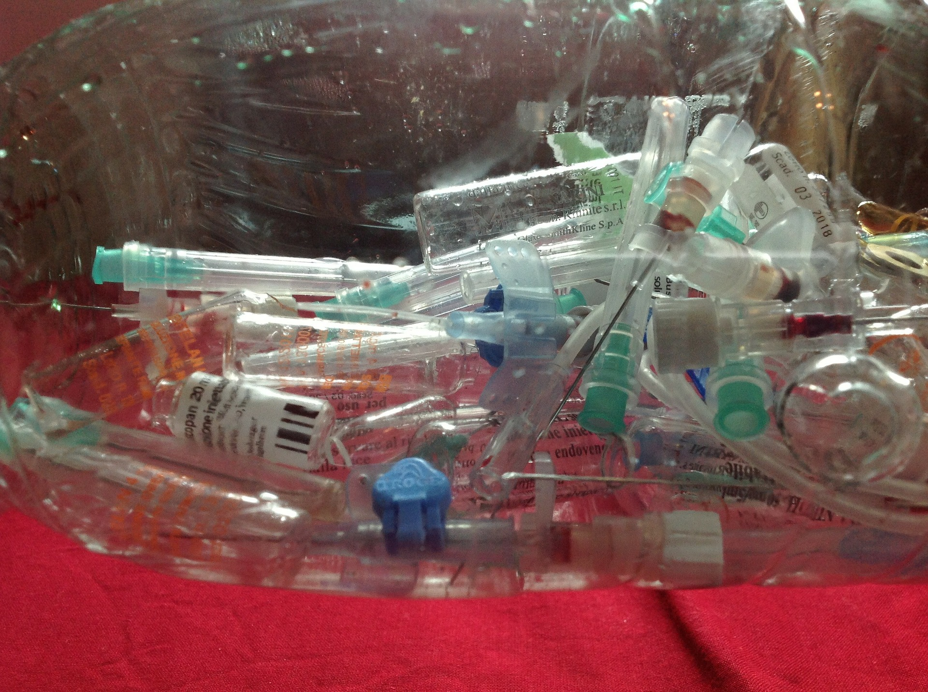
Medical Waste

Slide 2
What is medical waste?
Medical waste can be defined as waste that contains potentially infectious materials.
A broader definition may also include all materials that is of laboratory or medical origin, including packaging, infusion kits, etc.).
Medical waste can cause serious health issues if it is not disposed properly.
The types, treatment, disposal, causes, effects as well as solutions for medical waste are examined in the following.

Slide 3
Types of medical waste
Infectious
Pathological
Radioactive
Sharps
Pharmaceuticals
Genotoxic
Chemical
Non-hazardous

Slide 4
Causes
Dentists
Physicians
Retail health
Vets
Urgent care
Home healthcare
Assisted living facilities
Hospitals
Funeral homes
Research

Slide 5
Dentists
Dental waste can pose threats to the environmental system as well as on humans if not disposed and treated properly.
Dental waste includes plastic, glass, latex, cotton or other materials which may be contaminated with body fluids or other infectious substances.
Moreover, dental practices also cause waste related to toxic chemicals and elements like amalgam, mercury or solvents.
If these harmful substances are not disposed and treated in an appropriate way, they can cause severe health issues since microorganisms may get in touch with humans and may infect these people.

Slide 6
Physicians
There can also be medical waste produced by physician practices.
This can include waste from experiments which may come in the form of by-products of experiments.
It may also include used laboratory equipment.

Slide 7
Retail health
Retail health may also cause large amounts of medical waste.
This may include waste from drug packaging or used medical equipment.

Slide 8
Vets
Medical waste from veterinary offices may come in the form as non-hazardous as well as hazardous waste.
The non-hazardous waste can be disposed as regular office trash, while the hazardous fraction is subject to more careful disposal processes.
Veterinary waste mostly include biological materials contaminated with fluids from animals.
However, there can be also other forms of waste from veterinary offices, including radioactive waste from brachytherapy.

Slide 9
Urgent care
Waste from urgent care may include expired medications, trace chemotherapy waste or pathological waste products as well as general trash like paper cups and food scraps.

Slide 10
Home healthcare
Since the average age in our society increases on a steady basis due to better medical treatment, the demand for home healthcare also increases.
Moreover, people often prefer to stay at their homes instead of hospitals.
By doing so, home healthcare causes significant amounts of medical waste.
This medical waste from home healthcare includes lancets, syringes and needles.

Slide 11
Assisted living facilities
Medical waste is also caused by several assisted living facilities, including nursing homes, psychiatric institutions, convalescent homes and disabled persons‘ facilities.
Although most of the waste produced in these facilities is non-hazardous, a small part may also contain biohazardous waste.
Waste from assisted living facilities includes chemotherapy waste, sharps, radioactive waste and other hazardous waste items.
Thus, waste from assisted living facilities has to be collected, segregated and stored in an appropriate way in order to prevent public health issues.

Slide 12
Hospitals
Hospitals are another great source for medical waste.
Since they usually have all sorts of patients, they also produce many different types of medical waste.
This includes non-hazardous general waste as well as hazardous medical waste.
Hospital waste includes chemical, infectious, radioactive and pharmaceutical items as well as sharps, syringes and other materials.

Slide 13
Funeral homes
Funeral homes also produce many different kinds of medical waste.
These may include scalpels, scissors, cannulas, trocars or incision needles.
Since a fraction of this medical waste is classified as hazardous waste, funeral homes have to make sure that this fraction is disposed properly in order to avoid public health risks.

Slide 14
Research
There is also a significant amount of medical waste that is produced in research facilities.
This waste products include hazardous as well as non-hazardous medical waste.
The hazardous part may include medical waste that is contaminated with dangerous microorganisms which can cause severe health conditions.
Thus, the hazardous part of waste from medical research facilities has to be disposed with great care in order to prevent health problems for our society.

Slide 15
Effects
Meningitis
Parasitic infections
Blood poisoning
Infections of the skin
Candida albicans
Hepatitis
Diseases from vaccines
Methicillin-resistant Staphylococcus aureus (MRSA)
Sexual infections
HIV
Ebola
Environmental impact

Slide 16
Meningitis
Meningitis can be defined as an acute inflammation of the protective membranes covering the brain and spinal cord.
People who are diagnosed with Meningitis often suffer from symptoms like headaches, neck stiffness and fever.
Meningitis can be either bacterial or viral and can be transmitted by contaminated body fluids. Meningitis can thus be transmitted via contaminated syringes and needles.
Therefore, medical waste contaminated with Meningitis bacteria may cause severe health conditions if people get in touch with these waste products.

Slide 17
Parasitic infections
Medical waste can also lead to parasitic infections.
Materials that are contaminated with parasites may come from research institutions or laboratories.
If these contaminated waste products are not treated and disposed properly, they can lead to parasitic infections for humans and animals and may cause serious health conditions.

Slide 18
Blood poisoning
Blood poisoning (or also called bacteremia) is the presence of bacteria in the blood which can cause severe infections or other health complications.
It can also cause sepsis which can be life-threatening in many cases.
Blood poisoning can occur when contaminated needles or other infected instruments get in touch with the blood of patients.

Slide 19
Infections of the skin
Skin infections are usually caused by bacteria entering the skin through wounds or spreads.
Skin infections may lead to local swellings or other adverse effects.
If contaminated medical waste is not treated properly, the waste can cause skin infections if humans get in touch with the contaminated material.

Slide 20
Candida albicans
The infection with Candida is usually caused by Candida yeast.
The infection with Candida can come in many different forms.
Candida can cause serious health conditions, especially for elderly people or children which have weak immune systems.
Candida can be transmitted to humans if the contaminated medical waste is not disposed in an appropriate way.

Slide 21
Hepatitis
An incorrect treatment of medical waste may also result in the infection of patient with Hepatitis B and C.
Hepatitis causes an inflammatory condition of the liver and thus is a quite serious disease.
Hepatitis can be transmitted through medical waste if reused syringes are not disinfected properly.

Slide 22
Diseases from vaccines
Vaccines are quite helpful to humans to prevent serious health conditions.
However, if the used vaccine material is not disposed properly, it may pose serious health issues to the environment since the waste may still contain living pathogens which may spread into the environmental system and contaminate animals as well as humans.

Slide 23
Methicillin-resistant Staphylococcus aureus (MRSA)
MRSA can cause serious health issues since the bacteria is resistant against many antibiotics.
People with a weak immune system may suffer from severe health conditions or may even die since MRSA can often not be treated efficiently.
An infection with MRSA can happen if medical waste methods are not applied properly.

Slide 24
Sexual infections
Herpes and other sexual infections can be transmitted if medical waste is not disposed properly.
Even small contacts with these bacteria can lead to an infection of patients, either trough small breaks in the skin or through contaminated facilities like syringes that get in contact with the patients‘ blood.

Slide 25
HIV
HIV can also be caused by the use of contaminated syringes or other materials that get in touch with a patient’s blood.
Although HIV can be currently treated much better than in former times, it still is a quite serious and life-threatening disease.

Slide 26
Ebola
Especially in poor developing countries, Ebola still is a quite severe disease which causes many death each year.
Since it is quite contagious, contaminated medical waste has to be handled with great care in order to prevent a spread of the disease.

Slide 27
Environmental impact
Medical waste can not only pose serious health conditions to humans, it can also lead to an infection of animals if medical waste is not treated properly and they get in touch with this waste on landfills.
If animals are contaminated, they may transmit their diseases to other animals and the disease may be spread.
Eventually, even humans may be affected since we eat meat from farm animals which may also have been contaminated.

Slide 28
Solutions
Appropriate disposal of medical waste
Avoid medical waste
Government regulations
Subsidies
Research
Education
Work together

Slide 29
Appropriate disposal of medical waste
One main measure against medical waste and its possible adverse consequences it the appropriate disposal of medical waste.
In developed countries with good infrastructure, the appropriate disposal of medical waste is almost assured.
However, there are many poor countries who lack the knowledge and often also the financial circumstances to be able to assure a proper disposal of medical waste.
Especially in these countries, hospitals and other medical facilities have to be educated about the adverse negative consequences of an incorrect handling of medical waste on the environment.
Medical facilities should also be subsidized by local authorities or governments in order to be able to dispose medical waste appropriately.

Slide 30
Avoid medical waste
Another obvious but yet effective way to mitigate the problem of medical waste is to simply avoid the production of it.
However, this is easier said than done since in many cases, the medical waste cannot be significantly reduced.
For example, it is not possible to reuse needles in a safe way since they can transmit diseases to other people.
A more realistic concept would be to try to reduce the packaging material related to medical waste.
By doing so, significant amounts of medical waste could be saved.

Slide 31
Government regulations
Government regulations concerning the proper disposal of medical waste are an important factor in order to fight the adverse consequences of medical hazardous waste.
Strict rules have to be set by governments on how the disposal processes have to be carried out in order to avoid any adverse effects on the environmental system.
These government regulations should also take into account the latest research findings in order to be able to improve the disposal standards.

Slide 32
Subsidies
Especially in poor developing countries, it can make sense to financially support hospitals and other medical facilities.
Through this financial support, the medical facilities may be able to increase their standards regarding medical waste disposal.
This would increase the probability that the medical waste is disposed in a safe manner and thus would reduce the probability for medical waste related diseases.

Slide 33
Research
Research is crucial to further improve processes.
This is also true for the disposal of medical waste. If we are able to develop improved disposal processes or treatments for medical waste, we will be able to get rid of it in a cheaper and more effective way.
Thus, research on the topic of medical waste disposal is crucial to further increase our hygienic standards and to prevent the spread of diseases from an incorrect treatment of medical waste.

Slide 34
Education
Education could also mitigate the adverse effects of medical waste.
Educating nurses and doctors about the proper disposal of medical waste is obviously a crucial step in order to ensure safe processes.
However, we also should educate normal people on how to deal with their medical waste when they apply medicals at home.
By doing so, people will take more care when they dispose their potentially contaminated medical waste.

Slide 35
Work together
It is crucial to work together and to share the newest insights on medical waste disposal and treatment.
Especially for scientist, it is crucial to share their findings with other researchers in order to spread the knowledge to all countries in the world.
By sharing these findings, many people will benefit from this new insights and the medical waste disposal processes all over the world are likely to be improved.

Slide 36
Conclusion
Medical waste comes in many different types and can cause serious health conditions both for humans but also for the whole environmental systems.
Especially in poor countries with low regulatory standards for the proper disposal of medical waste, medical waste is often treated in an incorrect manner.
This could lead to a spread of contagious diseases and could potentially kill many people.
There are several measures to mitigate the medical waste problem.
Governments and researchers have to work together in a collective way and share their newest insights on improvements concerning medical waste disposal.
By doing so, we could improve the framework of medical waste disposal all over the world and thus accomplish a more effective way to fight the spread of diseases resulting from an incorrect treatment of medical waste.

Slide 37
Sources
https://www.municipalwasteeurope.eu/summary-current-eu-waste-legislation
https://www.epa.gov/regulatory-information-topic/regulatory-information-topic-waste
https://www.epa.gov/rcra/medical-waste

