Slide 1
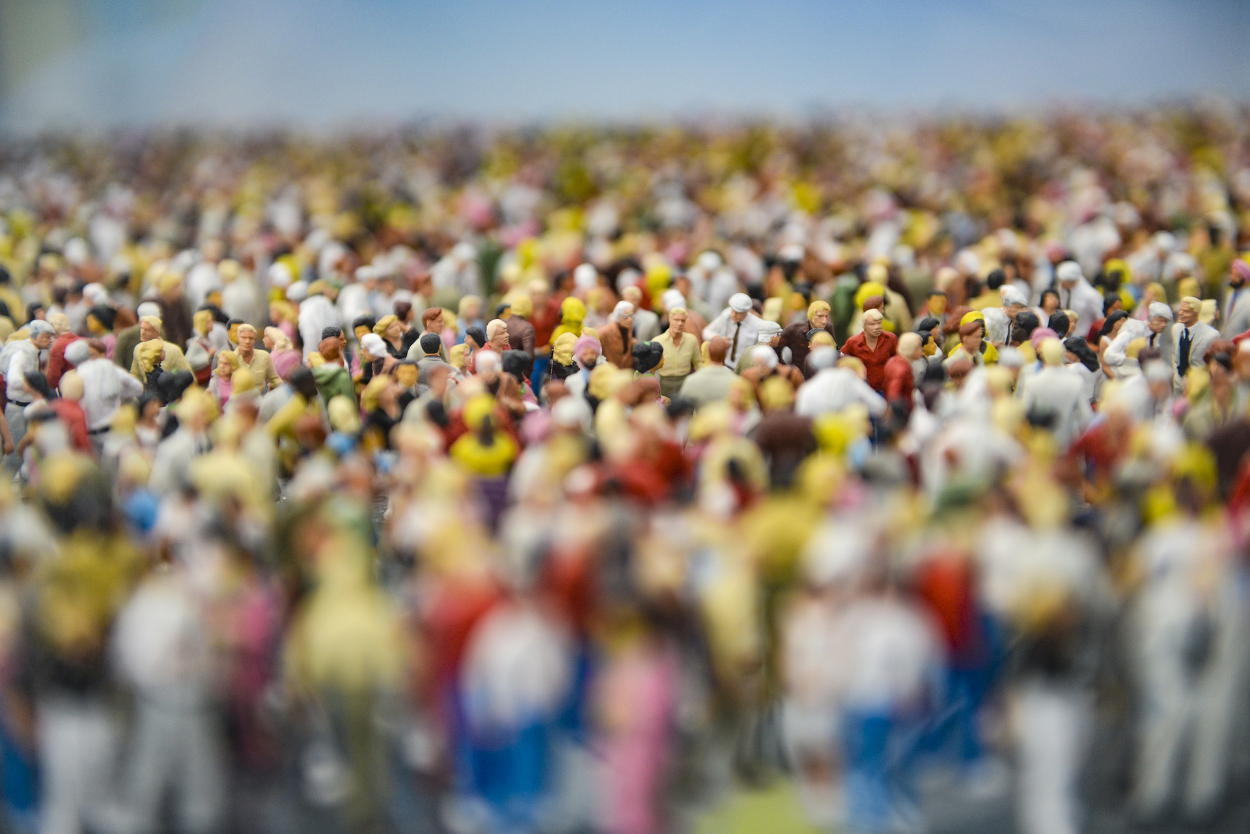
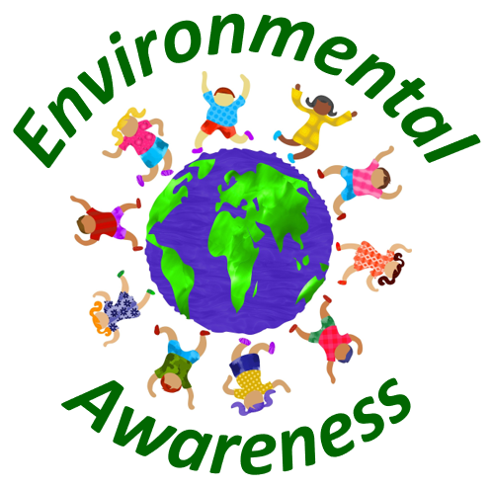
Overpopulation

Slide 2
What is overpopulation?
Overpopulation can be defined as a state in which there are too many people on the planet to supply them with basic things like drinkable water, food, breathable air and so on.
Overpopulation can also be defined as a state where the ecological footprint of humanity is bigger than the planet’s carrying capacity, meaning that the damaging process is faster than the repairment process carried out by nature, which eventually will lead to an economic collapse.
In the following, the causes, effects and also solutions to the overpopulation problem will be examined.

Slide 3
Causes
Improvement in medical knowledge
Decline in death rate
Industrial and agricultural revolution
Progress in food production
Poverty
Religious concerns
Migration and urban concentration
Immigration
Family planning

Slide 4
Improvement in medical knowledge
Our improvement in knowledge regarding the treatment of diseases leads to an increase in life expectancy.
This in turn leads to overpopulation since with the assumption of a constant birth rate, people live longer and thus more people will populate the planet at the same time.

Slide 5
Decline in death rate
Medical improvements combined with a better supply of food since the industrial revolution period means a vast decline in death rates.
When the birth rate stays unchanged and the death rate decreases, this means an overall positive effect on population growth.

Slide 6
Industrial and agricultural revolution
The industrial as well as the agricultural revolution had a big contribution to the overpopulation issue.
Since the production of food an other goods became quite due to the use of machines and the use of fertilizer and pesticides, people were able to raise more children, which in turn also raised more children.
As a results, there had been an overpopulation spiral which resulted in a vast number of people living on our planet right now.

Slide 7
Progress in food production
A related contributor to the overpopulation issue is the progress in food production.
Since farmers improved their knowledge on farming techniques, they were able to increase their crop yields significantly.
This led to an increase in wealth which resulted in more children and thus in a higher population number.

Slide 8
Poverty
At a first glance, this seems to contradict logical thinking.
Why should also poverty contribute to population growth?
The reason for that is that poor people often do not have governmental pension schemes.
Thus, they have to rely on their children to provide for them when they are no longer able to work.
As a result, especially in poor developing countries, the number of children is often much higher than in developed countries.
Moreover, children are often needed to work on their parents‘ field in order to be able to farm their land which also contributes to an increase in population.

Slide 9
Religious concerns
Another reason for overpopulation is that many people believe it is a sin to abort or even to use contraceptives.
Thus, without the use of contraceptives, population growth is a natural result.

Slide 10
Migration and urban concentration
Migration and urban concentration can lead to a local overpopulation.
The urbanization process continued to progress over the last decades.
This is due to the fact that work demand shifts from agricultural to the service sector.
Thus, people have to move to the cities to find work.
As a result, this can lead to an overpopulation of certain areas.

Slide 11
Immigration
Moreover, many people all over the world are forced to leave their home due to wars or famine.
This problem will be even bigger in the future due to the global warming issue.
Many farmers will no longer be able to sustain their crop yields since they will not have enough water supply anymore.
Thus, many people will try to migrate into countries which are not that much affected by the global warming problem and which provide higher living standards.
This also leads to a local overpopulation of certain areas.

Slide 12
Family planning
In many countries, people get married in a very early age.
Thus, they are likely to get more children over the course of their lifes.
Moreover, due to a lack of education and family pressure, women see it as their responsibility to get as many children as men want since they have often been told it is the only purpose of a woman to raise children.
This problem is especially severe in developing countries.

Slide 13
Effects
Environmental degradation
Depletion of natural resources
Wars
Mortality
Increase in crime rates
Loss in biodiversity
Increase in pollution
Ecological collapse
Water and food conflicts
Overextensive farming
Excessive use of fossil fuels
Loss of arable land and desertification
Antibiotic-resistant bacteria
Increasing probability of epidemics
Malnutrition and starvation
Increasing costs of living and housing
Rise in unemployment

Slide 14
Environmental degradation
Overpopulation has a vast adverse effect on the environmental system.
Since we have to produce large amounts of food to provide for an increasing number of people, we have to use more land and resources to accomplish this.
However, the use of more land comes with deforestation, which is especially severe in the Amazonian Rainforest.
This deforestation leads to a decline in the variety of species.
Moreover, local tribes lose their homes and their whole culture.
In addition, in order to produce more goods for our daily lifes, a bigger amount of fossil fuels is needed.
Burning fossil fuels lead to the emission of harmful chemicals and to acid rain.
Moreover, it contributes to the global warming issue.

Slide 15
Depletion of natural resources
Another related problem of overpopulation is the depletion of natural resources.
Our planet can only provided a limited amount of food and water.
When our population grows further, we will soon come to a point where we will no longer be able to supply the food and water necessary to feed all of them.
Even right now, people are starving every day.
This problem will get even worse in the future due to overpopulation.

Slide 16
Wars
Another consequence of overpopulation is an increasing number of wars.
Since people have to fight for their chunk of resources in order to survive, they are more willing to participate in wars to be able to provide for their families.
As population grows further, the probability of wars will do as well since a limited amount of resources has to be distributed to a growing number of people.

Slide 17
Mortality
The mortality rate, especially in poor countries, is likely to increase due to overpopulation.
This relates to the limited capacity of resources of our planet.
With an increasing number of people, everyone has to fight harder to get enough food.
Those who are not able to do that will be left behind, which results in an increasing mortality rate.

Slide 18
Increase in crime rates
Another problem of overpopulation is that the crime rate is likely to increase.
Since the number of poor people will increase due to overpopulation, a higher number of people will have the incentive for crimes like robbery, especially if this is their only hope to be able to buy basic things like food and water.

Slide 19
Loss in biodiversity
Population growth also leads to a loss in biodiversity.
As we need more space for farming or living, we destruct the natural environment of many species.
This problem is especially severe in the Amazonian Rainforest.
Due to farming and the related issues, many species go extinct each year.

Slide 20
Increase in pollution
Pollution is likely to increase due to overpopulation.
This is quite logic since with a larger number of people on our planet, we have to produce more food and other things for daily life.
This production of material goods leads to an increase in all sorts of pollution.
The air is polluted through the burning of fossil fuels.
Our rivers, lakes and also the sea are polluted through illegal dumping and waste disposal.
Our groundwater is polluted through the excessive use of fertilizers and pesticides.

Slide 21
Ecological collapse
Overpopulation can also cause a kind of ecological collapse.
The risk for such an event is especially severe if we look at our oceans.
Since humans like some kinds of fish much more than others, this can lead to a severe ecological problem.
Many of our preferred fishes consume large amounts of plankton.
If the number of these fishes is diminished, the plankton levels in our oceans will increase.
This leads to a reduction in oxygen levels, which in turn can lead fishes to leave the affected areas.
In the worst case, many sea animals will die from this development.

Slide 22
Water and food conflicts
Due to an increasing number of people who have basic needs, the likelihood for conflicts relating to water and food will increase dramatically.
This may lead to states where people literally fight for water and other resources for their daily lifes.

Slide 23
Overextensive farming
In order to meet the demand for food, farmers are likely to use an increasing amount of fertilizers and pesticides.
This leads to soil pollution and also affects our groundwater in an adverse way since chemicals through the soil.
Moreover, some animals will be contaminated by eating the crops containing high levels of pesticides.

Slide 24
Excessive use of fossil fuels
Overpopulation is likely to lead to an increased use of fossil fuels.
Fossil fuels are used in many different occasions in our lifes, for example for driving our cars or also for the production of other daily life products.
However, the use of fossil fuels is harmful to our environment since the gases produced in industrial processes contribute to global warming and also to air pollution.

Slide 25
Loss of arable land and desertification
If an area is used too extensively for farming or other purposes, it is likely to lose its fertility and thus this will lead to desertification.
With an increasing number of people, the probability for desertification will increase since the available land will be used more extensively in order to provide bigger crop yields.

Slide 26
Antibiotic-resistant bacteria
With an increasing population, there is an increasing demand for meat.
Intensive factory farming is used to be able to meet this demand.
However, this increases the likelihood for the development of antibiotic-resistant bacteria which can have immense adverse effects on humans.

Slide 27
Increasing probability of epidemics
Another related topic is the increase in the likelihood of epidemics.
A combination of overcrowded living condition and malnutrition in conjunction with low hygienic standards can lead to severe epidemics or pandemics.
This problem will be especially severe for poor people in developing countries since they also lack the money to afford medical treatment if necessary.

Slide 28
Malnutrition and starvation
Due to distribution problems of wealth, not all people will be able to meet their daily energy supply.
As a result, overpopulation will lead to death for many people, especially for the poorest among us.

Slide 29
Increasing costs of living and housing
With a limited amount of space to build houses and other infrastructure, a growing population is likely to lead to an increased cost of living.
We already see this nowadays as in many cities, it is almost not possible for people with average salary jobs to live there.
This problem will become even worse with overpopulation.
An increasing number of people will strive to live in the best places on earth, which will likely lead to an explosion of housing costs.
This is also true for goods of our daily lifes.
Since all sorts of commodities are limited, an increasing demand due to overpopulation will lead commodity prices to go up.

Slide 30
Rise in unemployment
The unemployment rate is likely to increase as a consequence of overpopulation.
There are simply not that many jobs to employ all people.
Moreover, due to artificial intelligence, it is likely that the unemployment rate continues to increase since many tasks will be performed by machines instead of humans in the future.

Slide 31
Solutions
Improvement of family planning
Raising awareness on the topic
Education
Birth regulation
Extraterrestrial settlement

Slide 32
Improvement of family planning
People all over the world should be aware on what it means to provide for a family and of the costs relating to it.
People should ask themselves if it may be better to limit the number of children they want.
It is in our all interest to limit the number of people on our planet in order to keep it intact and viable.

Slide 33
Raising awareness on the topic
Another related point is to increase peoples‘ awareness towards the topic of overpopulation.
Many people may never heard of this issue since it is quite normal for them to have as many children as possible.
If they put the number of children in context to the overpopulation issue, it may become clear to many people that overpopulation may kill the whole planet if we do not change our behavior.

Slide 34
Education
Education is key, also in the context to mitigate the overpopulation problem.
As we have seen earlier, poor people are likely to have more children than rich people.
This is due to the fact that poor people usually do not have pension schemes and thus depend on their children to provide for them when they are old.
Thus, education can help people to get out of poverty and thus it can indirectly contribute to a reduction in population growth.

Slide 35
Birth regulation
If people will not become responsible enough to reduce the number of children, the governments will be forced to intervene and set strict regulations on the number of children that are aloud.
A prominent example of this strategy is China with its one child policy.

Slide 36
Extraterrestrial settlement
Another way to fight overpopulation relates to the science fiction literature.
With extraterrestrial settlement, we could move part of our population to other planets or space habitats and thus could mitigate the overpopulation issue.
However, this option can be regarded as quite unsecure and has to be validated in the future.

Slide 37
Conclusion
Overpopulation is a serious threat to our whole environmental system.
It is likely to cause severe conflicts and wars as people will fight for resources in order to meet their daily energy demand.
It is therefore crucial that we solve this issue through suitable and sustainable measures.
Only then, it will be possible for humanity to live in peace in the future.

Slide 38
Sources
https://en.wikipedia.org/wiki/One-child_policy
https://www.compassion.com.au/blog/why-do-the-poor-have-large-families
https://en.wikipedia.org/wiki/Human_overpopulation

